Slide 1
Spectroscopic and photometric investigation of selected hot stars
Bc. Alžběta Oplištilová
Supervisor: prof. RNDr. Petr Harmanec, DrSc.
Astronomical Institute of Charles University

Slide 2
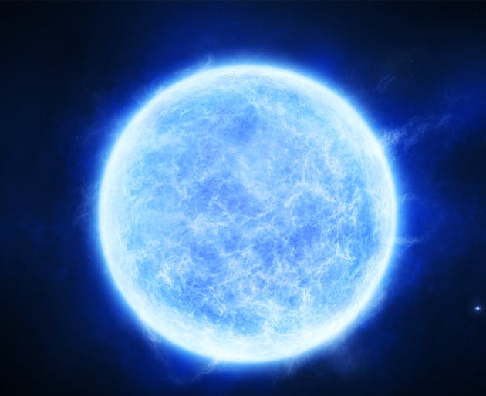
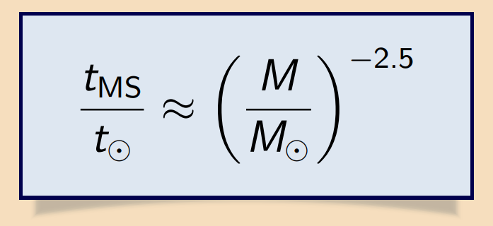
Hot stars
spectral types: O, B, (A)
effective temperature > 10 000 K
high luminosity
massive → short-lived (~10⁷ yr on the main sequence)
<číslo>
Notes:
<číslo>

Slide 3
Motivation for studying hot stars
rapid nuclear reactions → the most important contributors of heavy chemical elements (stellar winds, core-collapse supernovae)
understanding the chemical composition of galaxies
the majority of hot stars originate in binary or multiple star systems
Abt (1983), Raghvan et al. (2010), Moe and Di Stefano (2017)
not explained why
<číslo>

Slide 4
δ Ori A
ω CMa
Multiple star system
very numerous in the universe
20% of observable stars
the uncomplicated determination of stellar parameters
Be star
class B
optical spectra — include or have included at least one Balmer emission line
Be phenomenon — not fully understood
<číslo>

Slide 5
Importance of δ Ori A
class O — rare due to their short lifetimes
50 O stars with known parameters in the Milky Way and Magellanic Clouds
mass-transfer between companions → difficulties in analyses
best candidates: multiple star systems with minimal mass loss
<číslo>

Slide 6
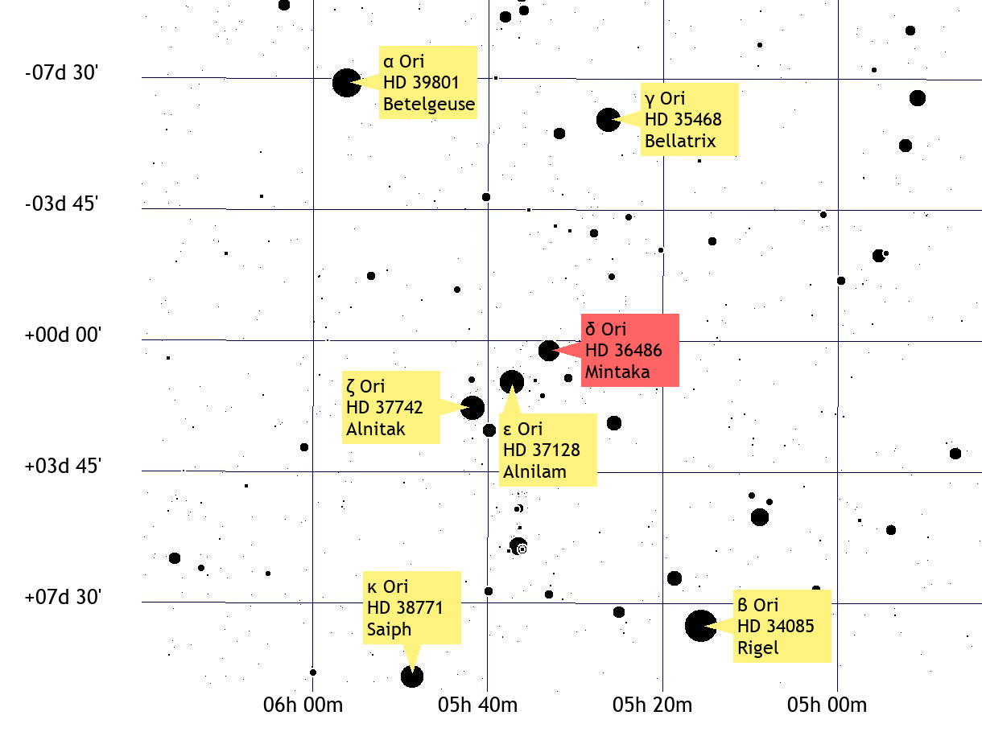
δ Ori A
other designations:
Mintaka
HD 36486
HR 1852
HIP 25930
Source: TheSky
(astronomy software)
<číslo>

Slide 7
Structure
*
***
**
* Leone et al. (2010)
** Mayer et al. (2010)
*** Tokovinin (2014)
7

Slide 8
Recent studies
Harvin et al. (2002)
unexpectedly low masses
Mayer et al. (2010)
confusion of secondary and tertiary in Harvin‘s study
the spectral lines of the primary and tertiary dominate
the optical spectra → normal masses, q ≈ 0.4
Harmanec et al. (2013)
the secondary in the red spectral region
Corcoran et al. (2015), Nichols et al. (2015), Pablo et al. (2015), Shenar et al. (2015) — series of four detailed studies
Oplištilová et al. (2020) — the secondary in the blue spectral region
<číslo>

Slide 9
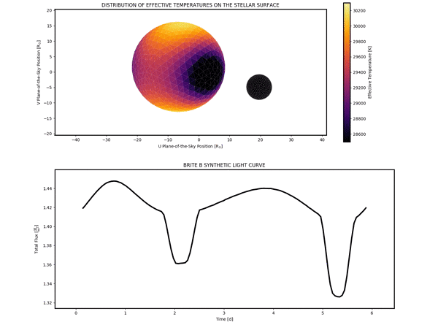
δ Ori A: goals
P = 5.732436 d
the analysis of the system‘s properties (KOREL, Pyterpol)
solving the inverse problem (PHOEBE 1)
conjecture: the presence
of circumstellar material
around the star
Aa1
T (K)
Aa2
Magnitude
created in
PHOEBE 2
Time
<číslo>

Slide 10
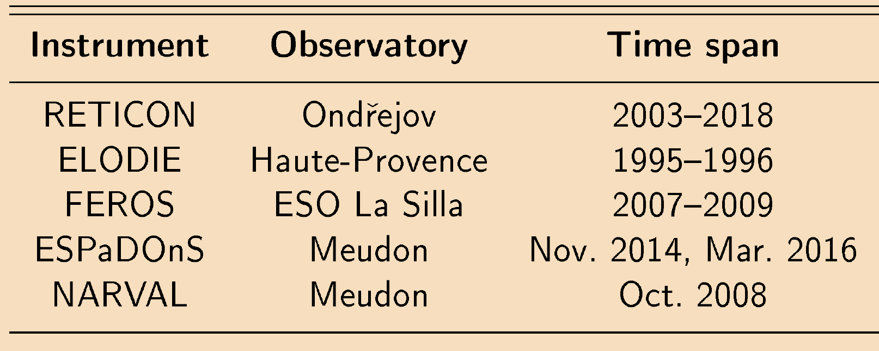
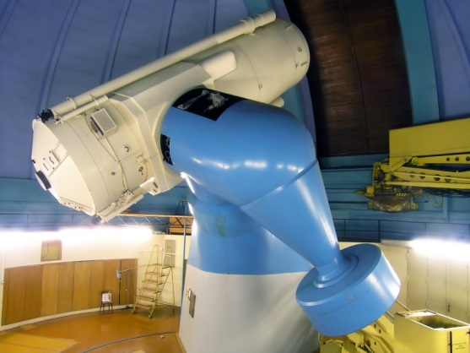
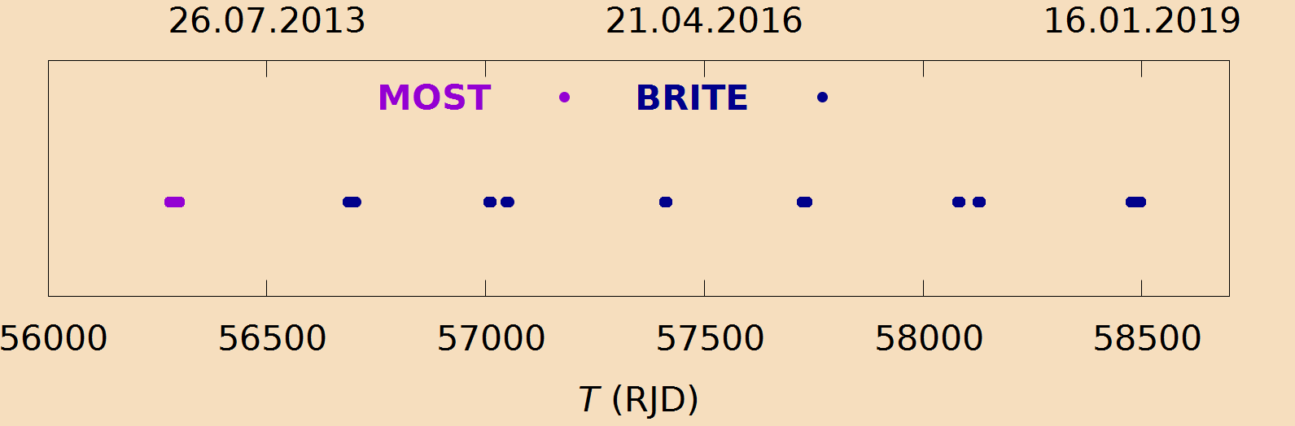
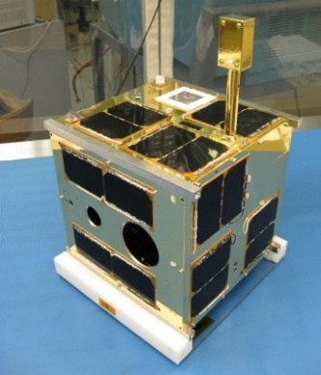
δ Ori A: data
2m-telescope, Ondřejov Observatory
spectroscopy:
321 red spectra
145 blue spectra
473 spectra (exp. 50 s)
photometry:
MOST BRITE
<číslo>

Slide 11
Data analysis
the reduction of spectra
reSPEFO2¹
rebinning to a scale linear in RV
HEC35D²
disentangling
KOREL³
fitting observed and model spectra
PYTERPOL⁴
LC + RV* curves
PHOEBE 1⁵
¹ written by Adam Harmanec; https://astro.troja.mff.cuni.cz/projects/respefo
² writen by Petr Harmanec; http://astro.troja.mff.cuni.cz/hec/HEC35
³ Hadrava (1995, 1997); http://www.asu.cas.cz/~had/korel.html
⁴ Nemravová et al. (2016); https://github.com/chrysante87/pyterpol/wiki
⁵ Prša and Zwitter (2005); http://phoebe-project.org
* Mayer et al. (2010)
<číslo>

Slide 12
Solution in KOREL
Problems in the solution of this system:
lines of the primary and tertiary are blended
the primary and tertiary dominate
faint secondary spectrum
the dependence of the sum of squares on q is flat
12

Slide 13
Spectral disentangling in two steps
the first step the second step
the spectra of the primary and tertiary are disentangled
residuals of all components after disentangling
+ 1
the spectrum of the secondary is disentangled
13

Slide 14
KOREL — chains
q = 0.41549 e = 0.07583
disentangled:
the primary and tertiary with variable intensities
convergence of:
T₁, e, ω, K₁
(orbit of close pair)
T₂, K₂
(outer orbit)
disentangled:
the primary and tertiary with variable intensities
convergence of:
T₁, e, ω, K₁
(orbit of close pair)
T₂, K₂
(outer orbit)
disentangled:
the primary and tertiary with constant intensities and the secondary with variable intensity
convergence of:
T₁, q
(orbit of close pair)
disentangled:
the primary and tertiary with constant intensities and the secondary with variable intensity
convergence of:
T₁, q
(orbit of close pair)
disentangled:
all three components with constant intensities
convergence of:
T₁, e, ω, q, K₁
(orbit of close pair)
T₂, K₂
(outer orbit)
disentangled:
all three components with constant intensities
convergence of:
T₁, e, ω, q, K₁
(orbit of close pair)
T₂, K₂
(outer orbit)
14

Slide 15
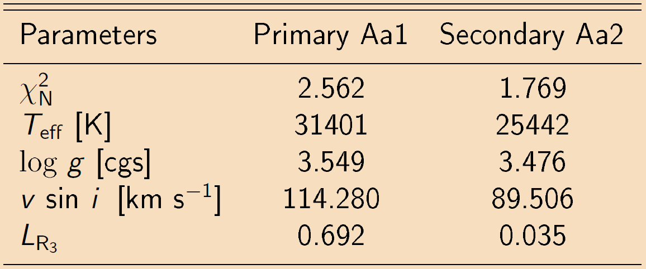
PYTERPOL
finds the fit between observed spectra and synthetic spectra
simplex minimisation technique
15

Slide 16
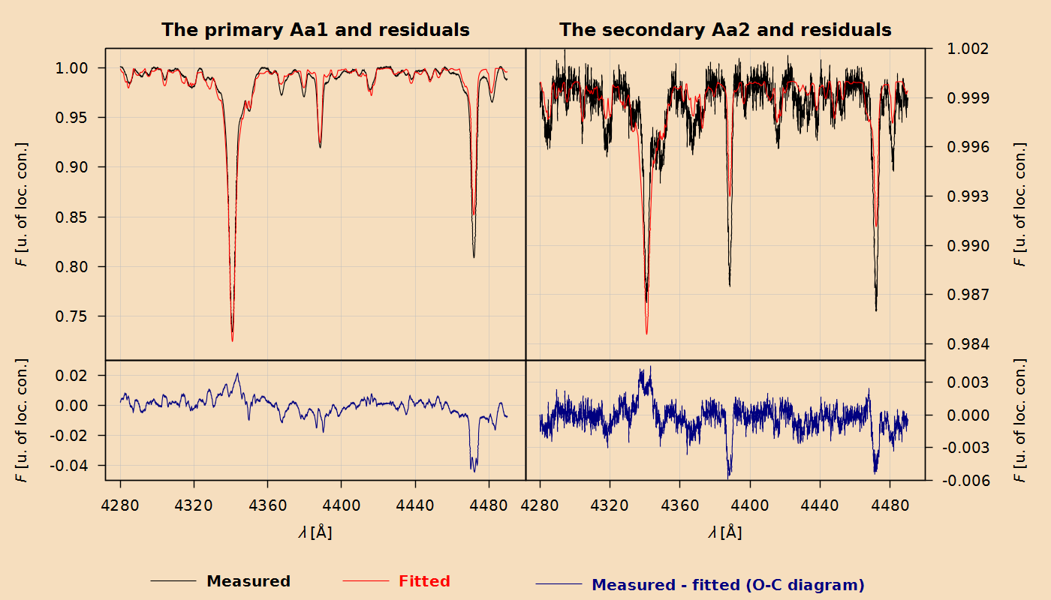
u. of loc. con. = unit of local continuum
<číslo>

Slide 17
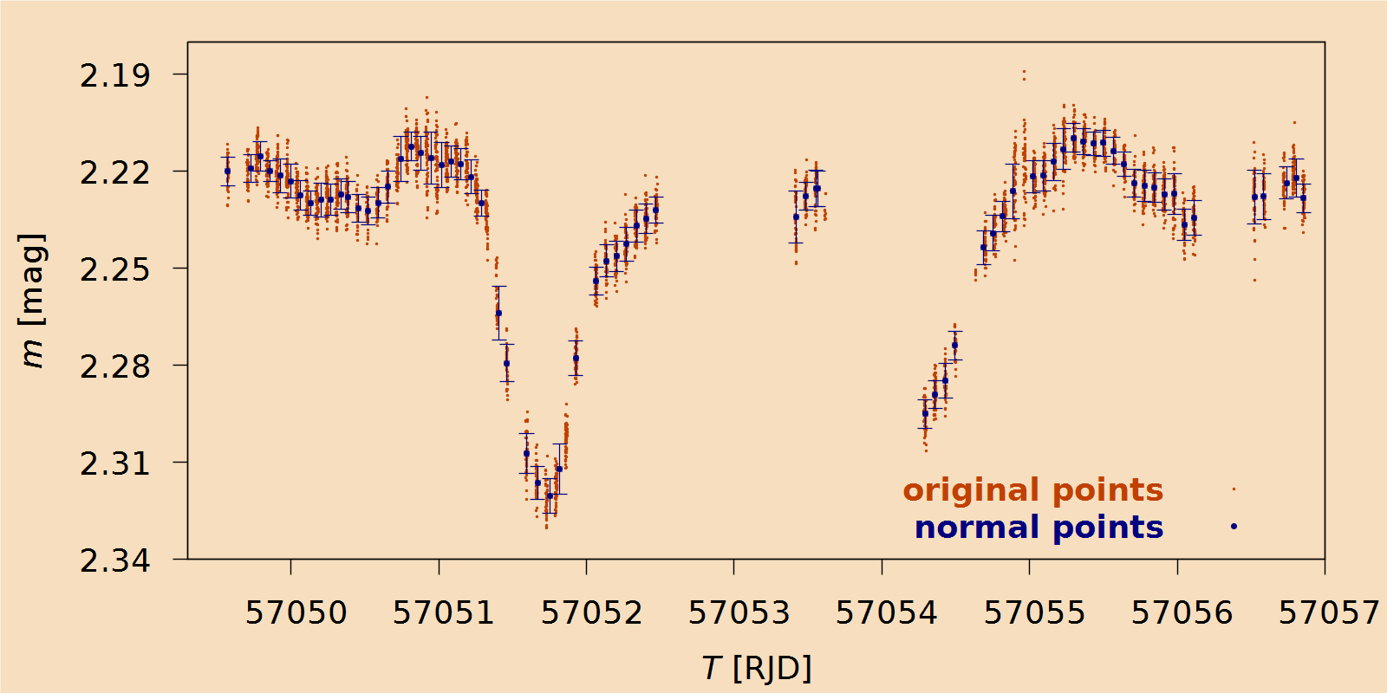
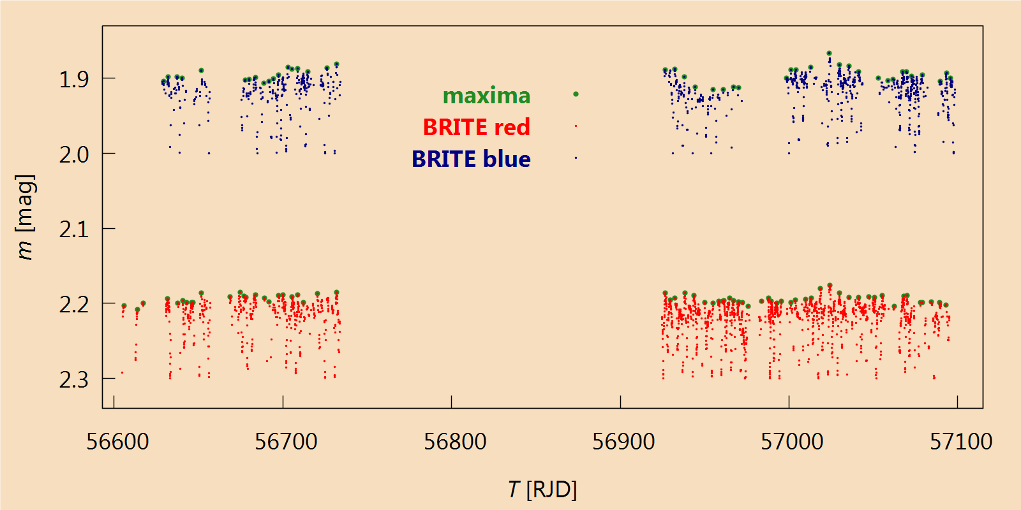
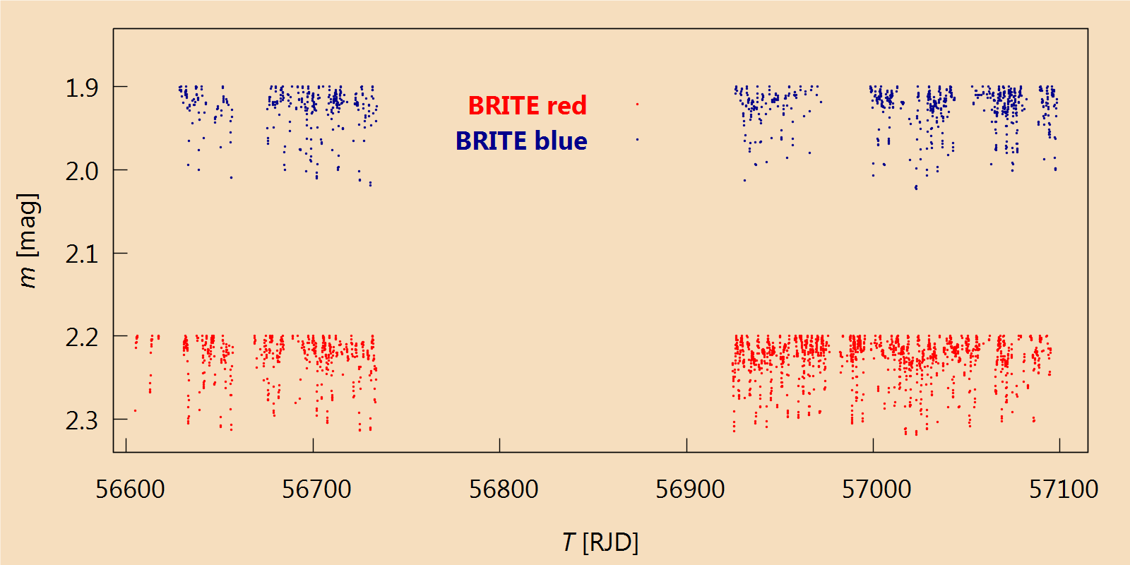
Homogenisation of photometric data
17

Slide 18
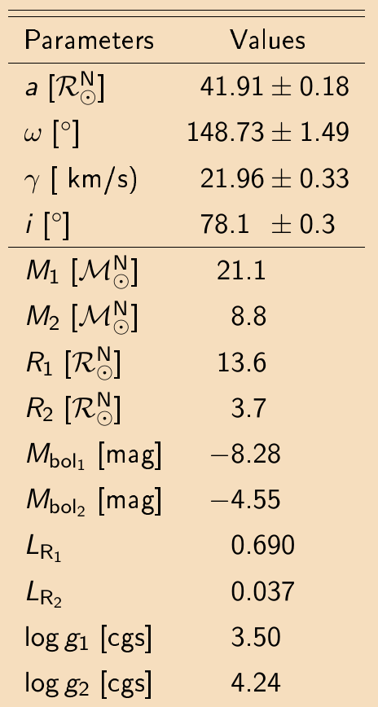
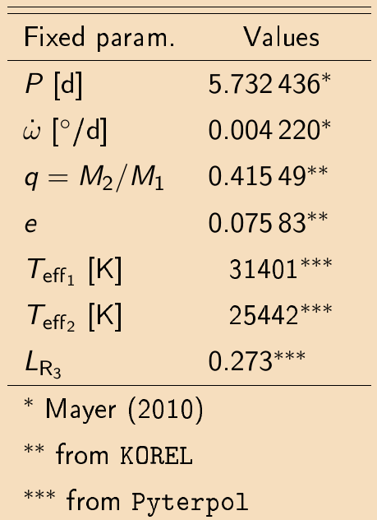
PHOEBE 1 — solution
<číslo>

Slide 19
Comparison with theoretical values
results
19

Slide 20
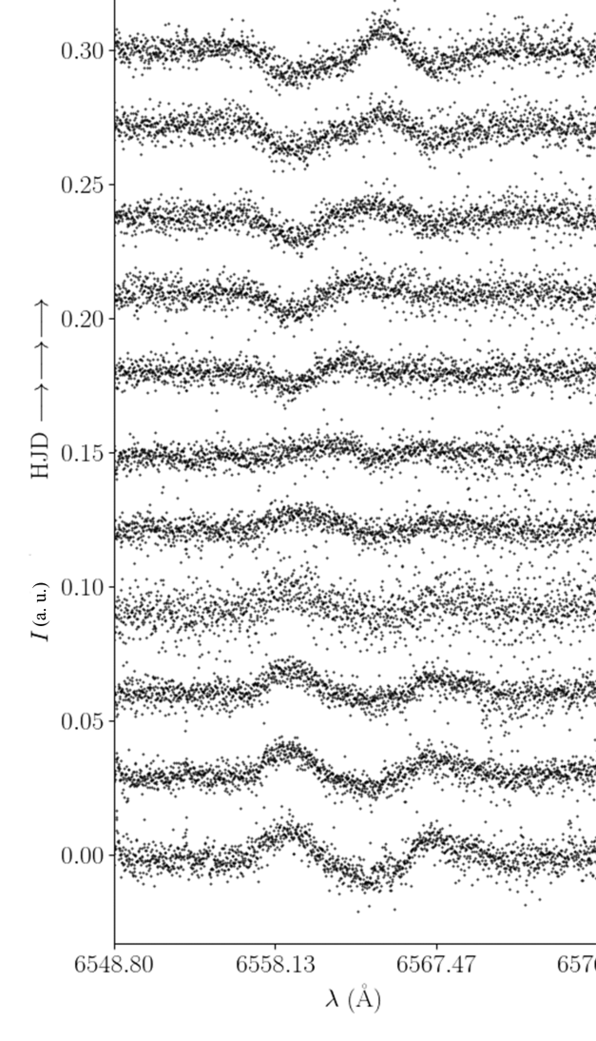
Presence of circumstellar material
Narval, ESPaDOnS data
changes of shapes of H_{α} lines
no clear interpretation:
the variable amount of circumstellar material
the evidence of rapid line-profile changes reported by Kholtygin et al. (2006)
residual spectra 05.11.2014
0.30
0.25
0.20
0.15
0.10
0.05
0.00
F [arb. u.]
T → → →
6548.80 6558.13 6567.47
λ [Å]
20

Slide 21
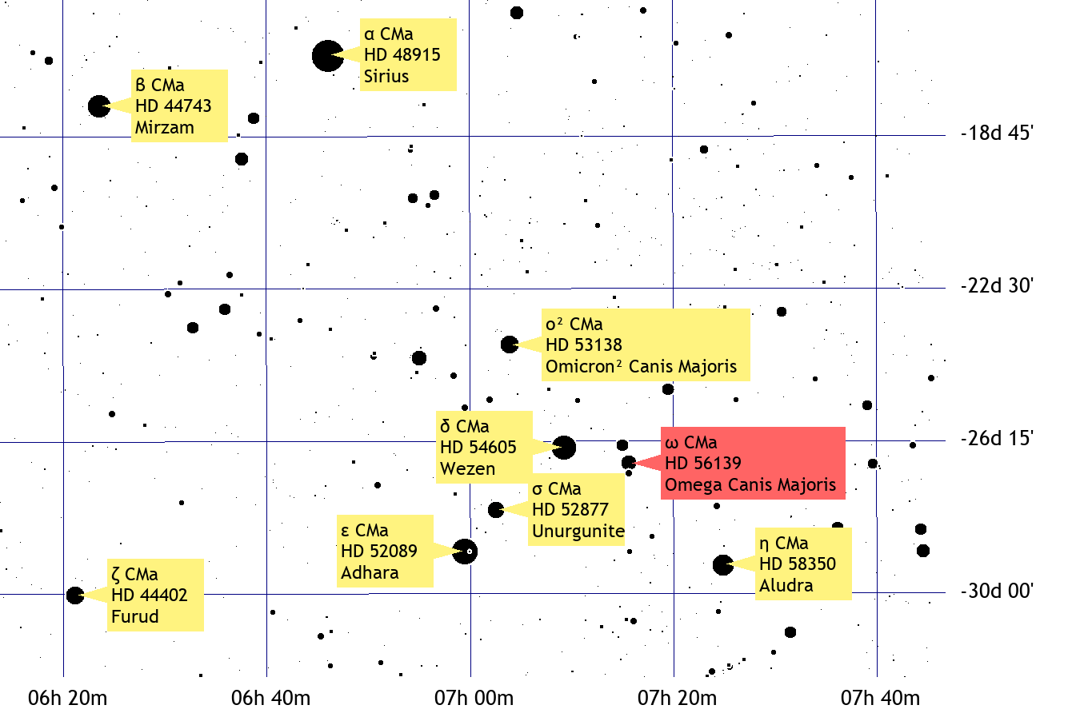
ω CMa
Class: B2e
other designations:
28 CMa
HD 56139
HR 2749
HIP 35037
Source: TheSky (astronomy software)
<číslo>

Slide 22
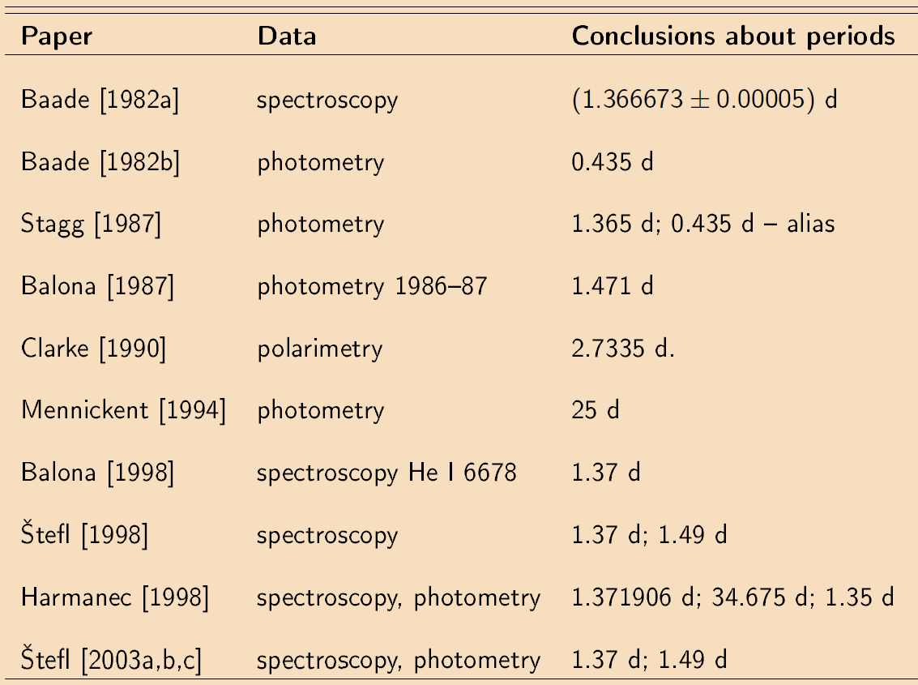
Motivation ω CMa
<číslo>

Slide 23
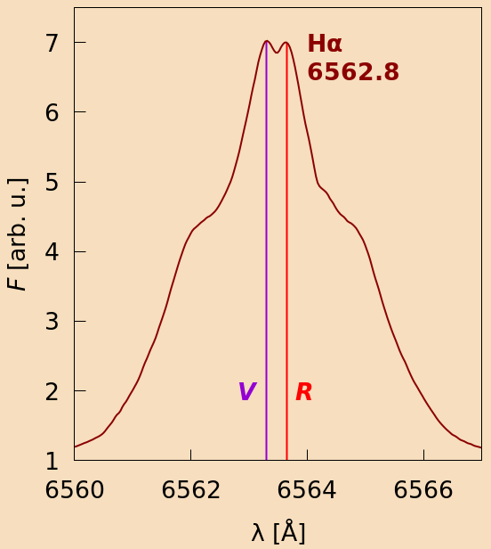
ω CMa: goals
studying periodic variations in:
radial velocity RV (He I 6678.151 Å),
asymmetry of line profiles (He I 6678.151 Å),
V/R ratio (H_{α})
testing the conjecture: the variations in the period correlate to the extent
of the circumstellar envelope
the O — C analysis (from RVs and asymmetry)
the strength and equivalent width of the H_{α}
<číslo>

Slide 24
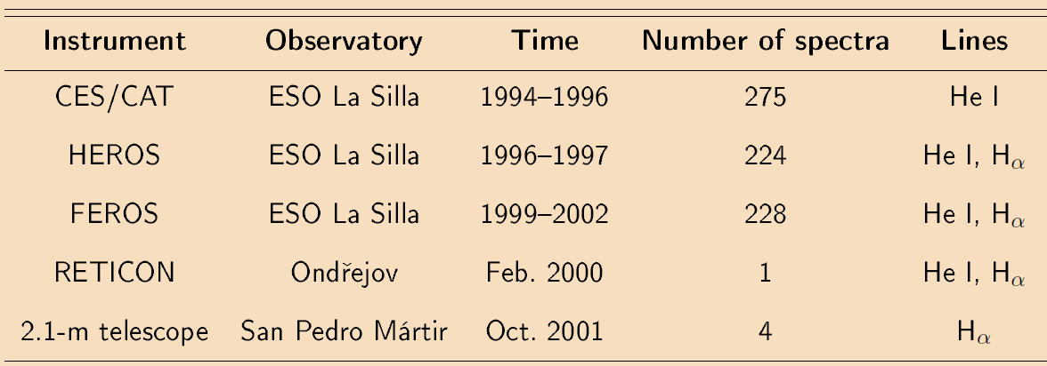
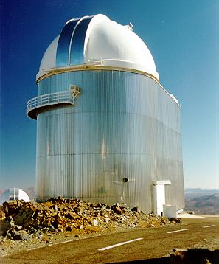
ω CMa:
data
Spectra
RVs at the core of He I 6678.151 Å
Feros, La Silla
H_{α} W_{λ}: 7 values (1978—1987), (V/R)/2: 10 values (1981—1993)
15 spectra from BeSS database
<číslo>

Slide 25
Measurements
V/R ratio
emission strength (V+R)/2
equivalent width W_{λ}
radial velocity
asymmetry of line profiles
H_{α} 6562.81 Å
He I 6678.15 Å
reSPEFO2*
IDL program TheBisectorMethod
*new version of SPEFO (Jiří Horn) written by Adam Harmanec
https://astro.troja.mff.cuni.cz/projects/respefo/
25

Slide 26
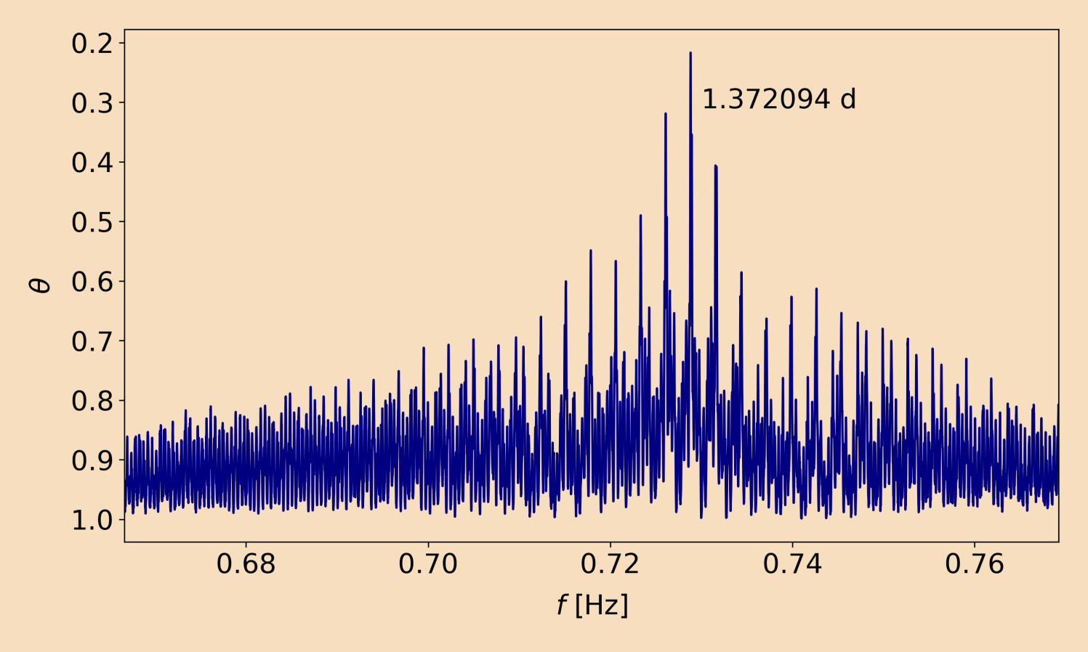
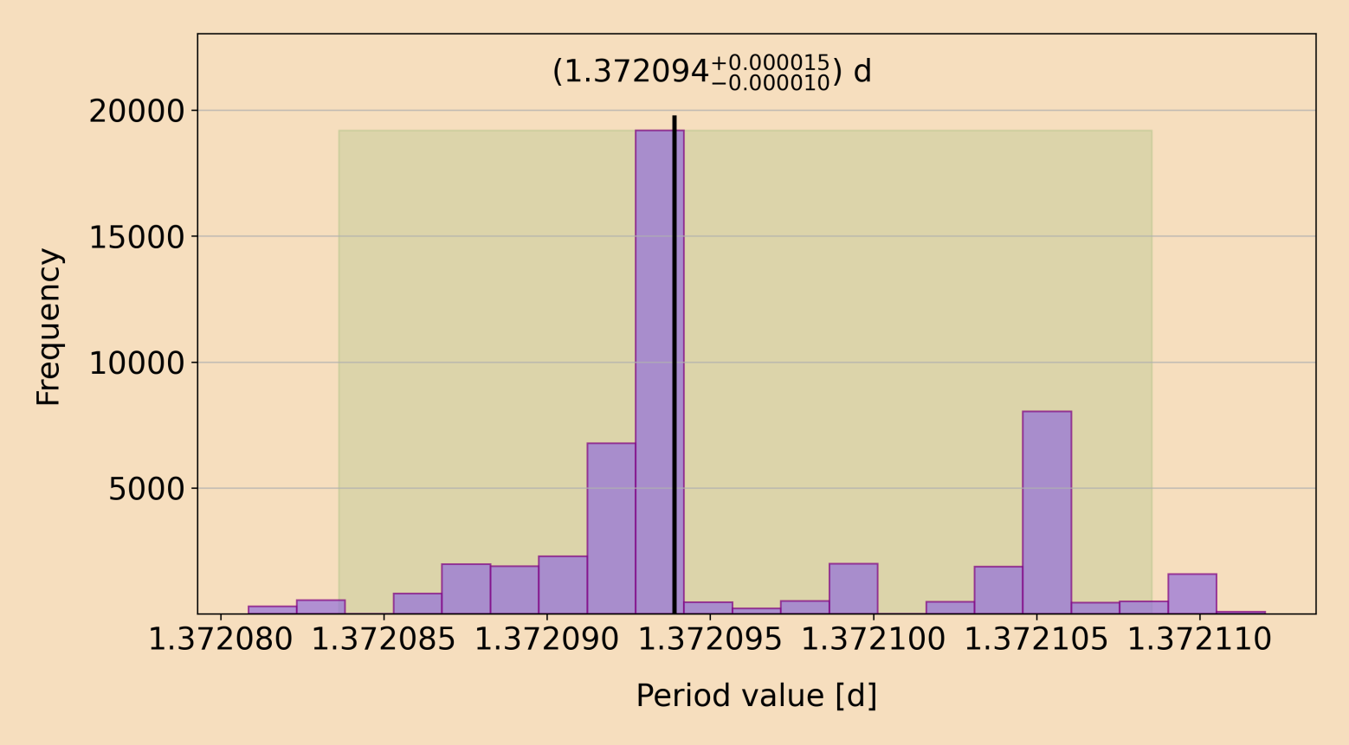
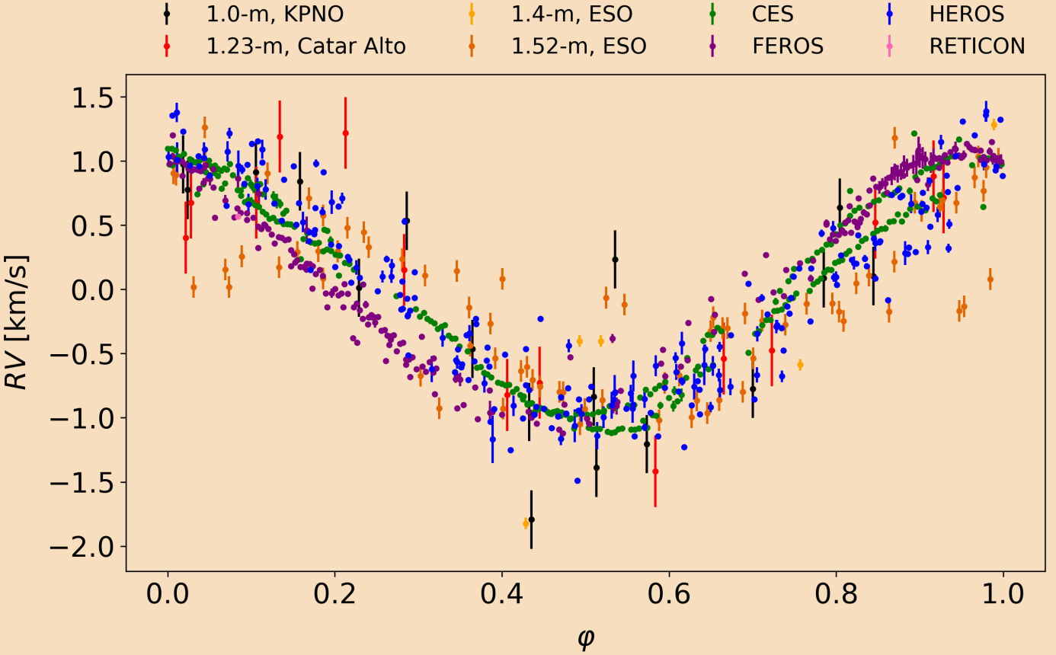
RVs at core of He I 6678.151
local groups
normalisation:
(γ — K, γ + K) → (—1, 1)
Stellingwerf‘s method
published value P = (1.371906 ± 0.000013) d Harmanec (1998): data 1970—1983
<číslo>

Slide 27
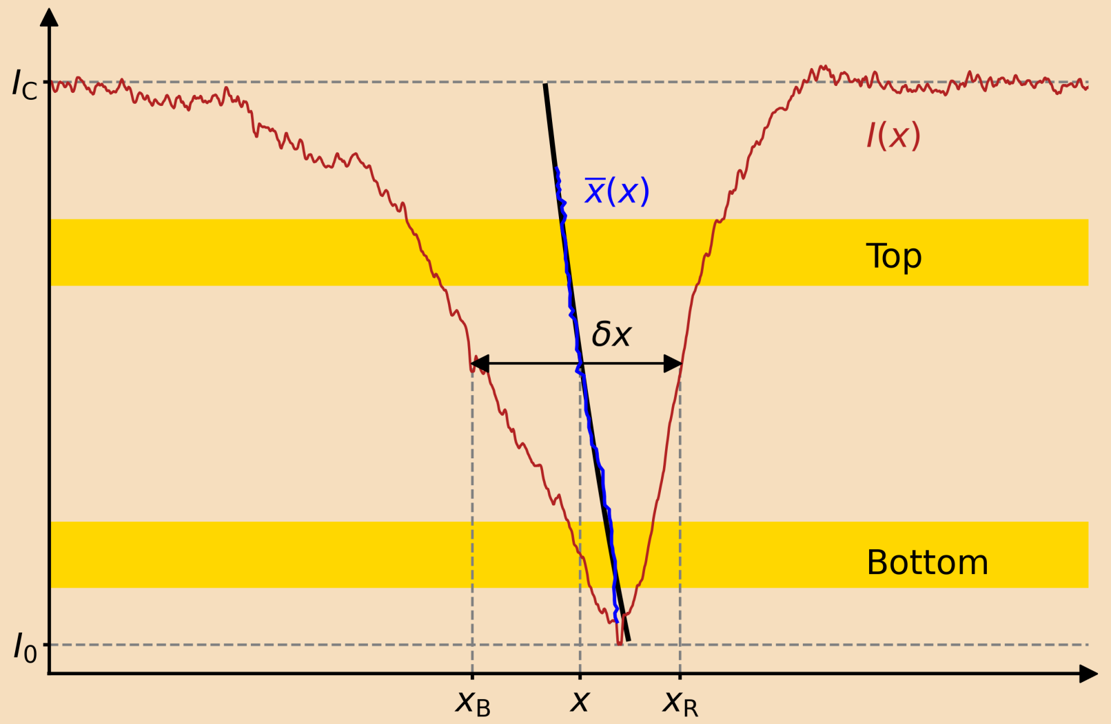
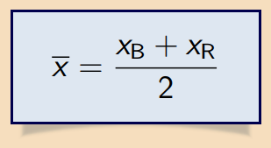
The bisector method
Bisector velocity span
<číslo>

Slide 28
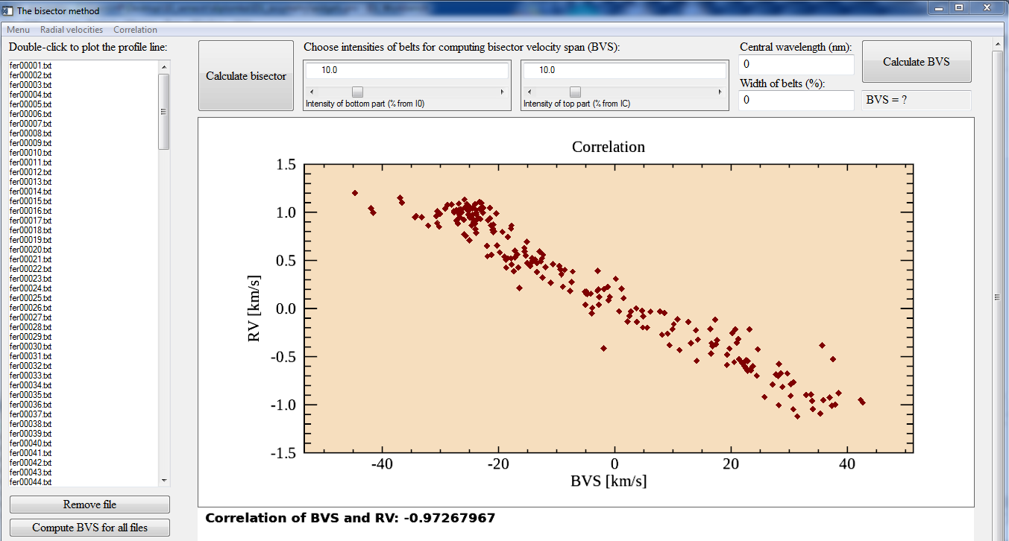
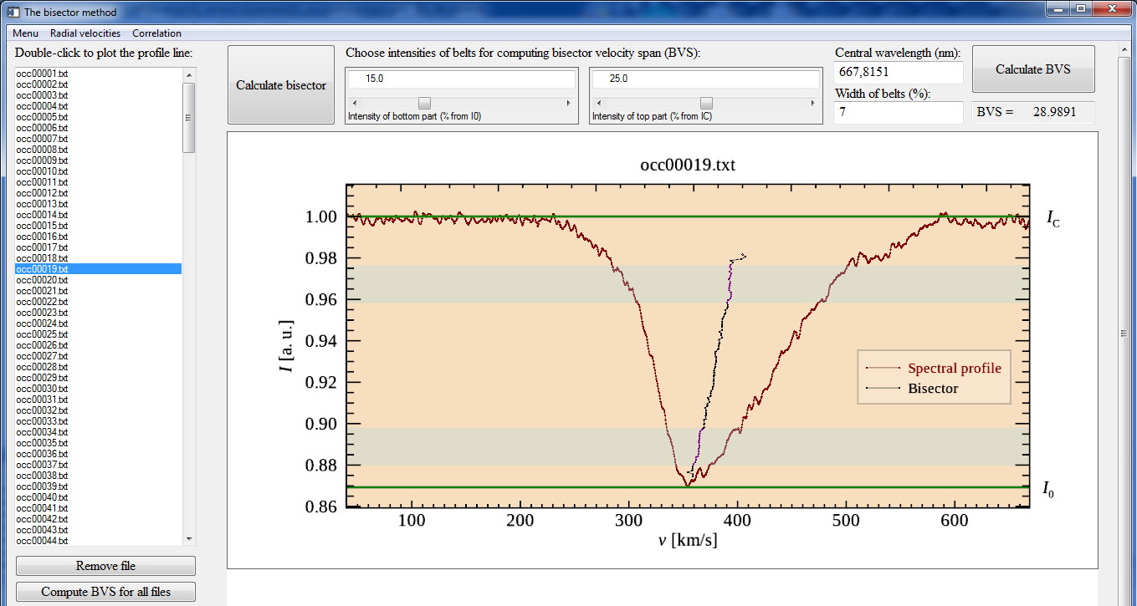
IDL program TheBisectorMethod
available at: https://github.com/BetkaOpl/The-bisector-method
<číslo>

Slide 29
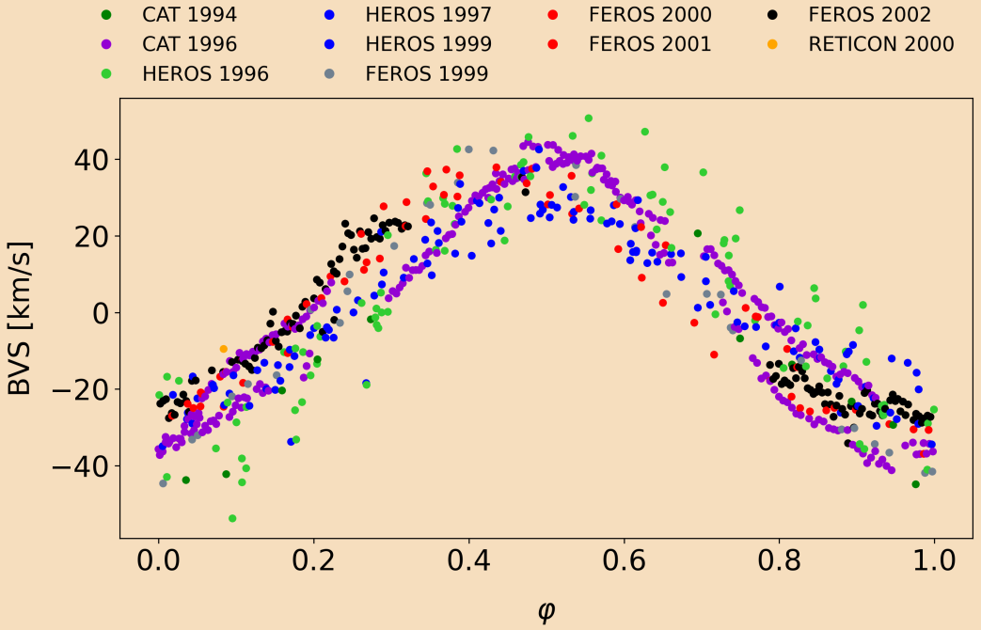
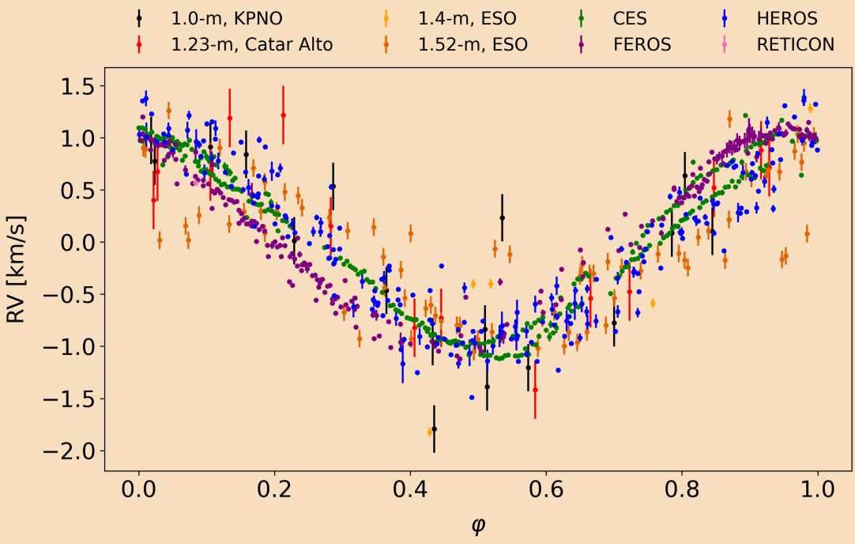
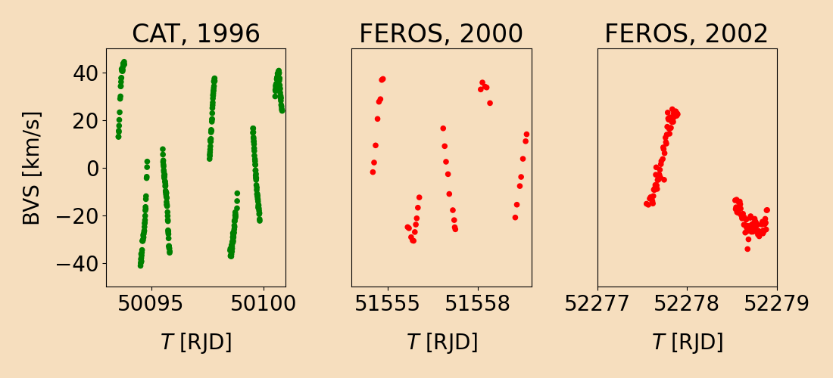
<číslo>

Slide 30
The O — C analysis from RVs and BVSs
investigation of additional variability to the mean period → O — C
SPEL*: computing circular orbits → local epochs of the observed RV curve maxima
computing O — C deviations of local epochs and linear ephemerides of RV maxima
SPEL computation
P = 1.372094 d
e = 0
ω = 0°
K = 1 km/s or ?
T_{maxRV} ?
γ ?
fixed
fixed for RVs,
computed
for BVSs
computed
50095.8251 RJD
reference epoch (CES data)
1.372094 d
* written by Jiří Horn: Horn et al. (1994, 1996)
<číslo>
Notes:
<číslo>

Slide 31
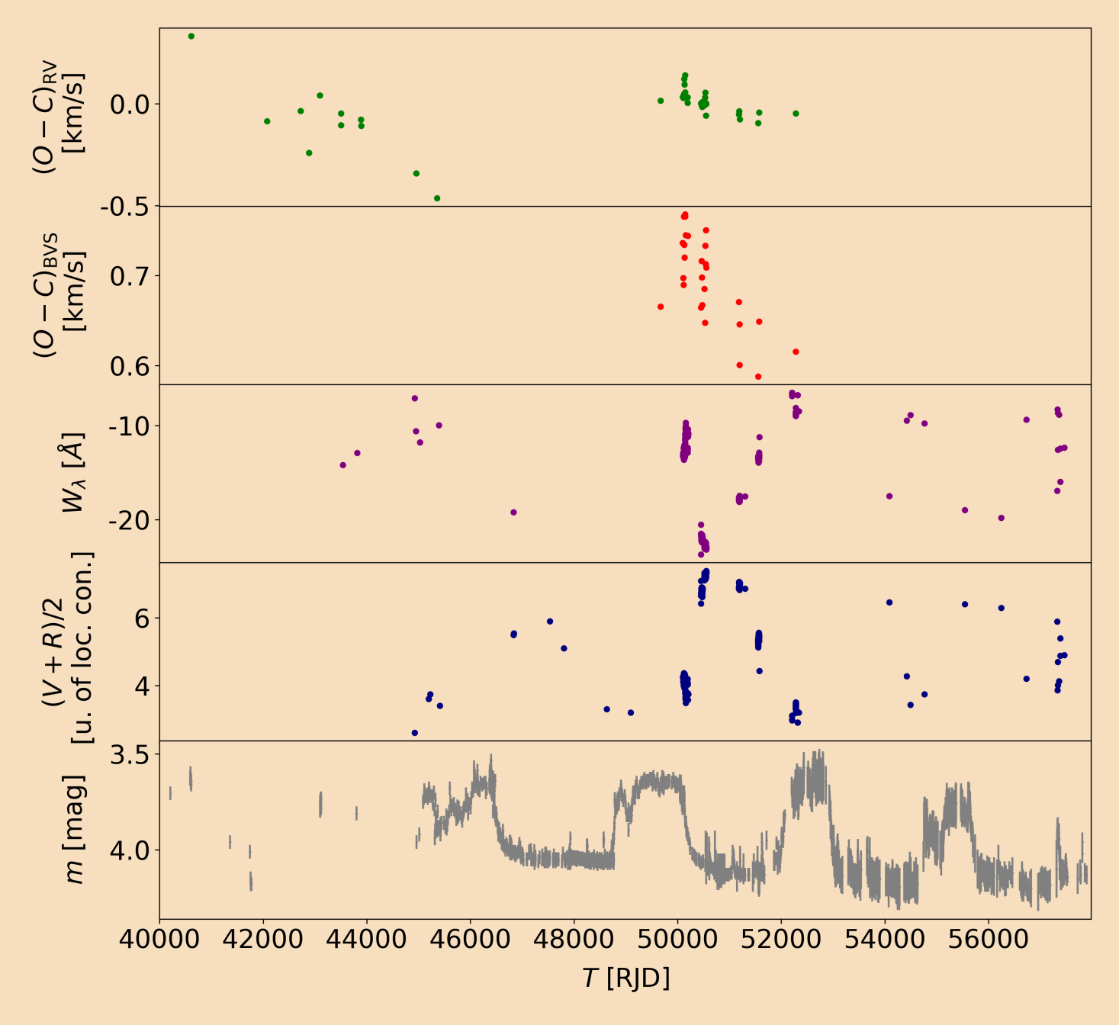
Results
the extent of the circumstellar envelope seems to correlate with the changes in period
changes in P ≈ 1.37 d
depend on the presence
or absence of the
emission in the star‘s
spectrum
Ghoreyshi et. al (2018)
u. of loc. con. = unit of local continuum
<číslo>

Slide 32
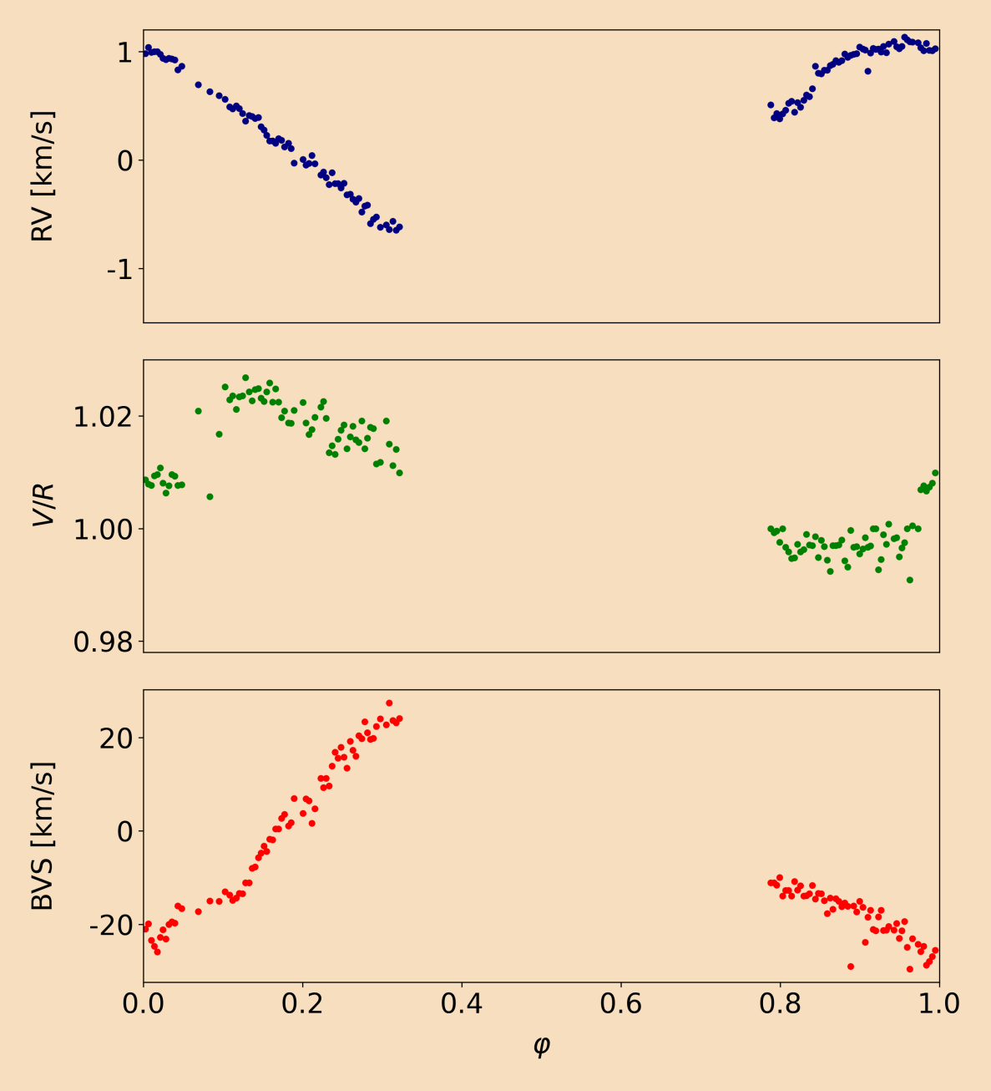
Results
3rd, 4th January 2014
FEROS spectra
RV max ↔ R wing is shorter ↔ BVS < 0
RV min ↔ V wing is shorter ↔ BVS > 0
<číslo>

Slide 33
Conclusions
δ Ori A
the weak secondary disentangled
parameters of the eclipsing binary (q = 0.41549, e = 0.07583, R₁ = 13.6 MS ,
R₂ = 3.7 , M₁ = 21.1 , M₂ = 8.8 , …) determined
changes in the shape of the H_{α} detected — no clear interpretation
ω CMa
mean period of RV changes P = 1.372094 d
measured RVs (→ O — C), BVSs (→ O — C), V/R, W_{λ}, and strength of the emission
changes in period seem to correlate to the extent of the circumstellar envelope
Thank you for your attention
<číslo>

